Slide 1
Computer Art
Semester Review
DIRECTIONS
Answer the following questions using the PDF documents supplied.
The Links to these files are located on our class website.
http://lthscomputerart.weebly.com/lectures.html

Slide 2
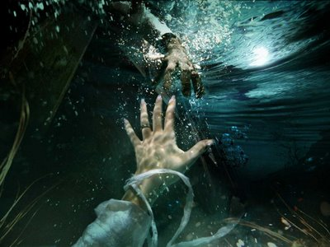
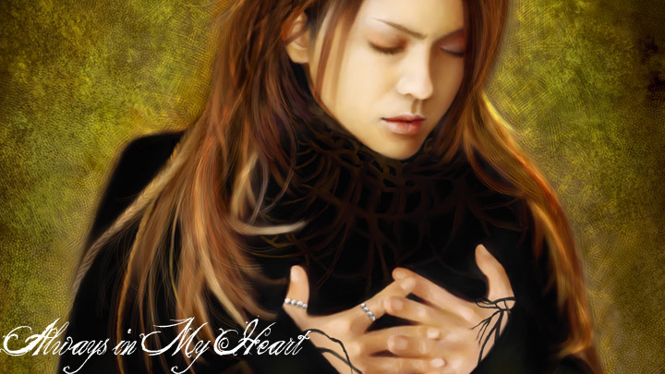
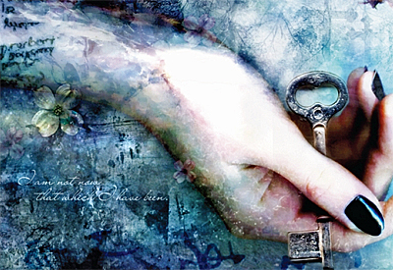
This type of art is composed of individual pixels similar to a real photo. It can be generated by an artist with a paint program or scanned-in from a printed original.
01 Intro to Digital Art

Slide 3
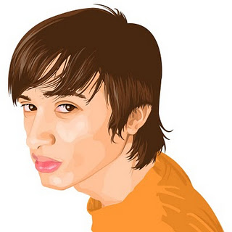
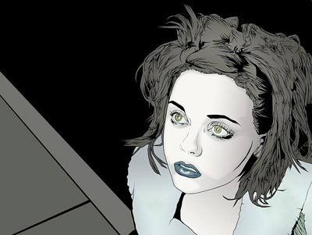

This type of art is created with mathematical formulas and hence can be enlarged or reduced in size without any loss of quality and definition.
01 Intro to Digital Art

Slide 4
This type of device used in computer art uses a subtractive color system of cyan, yellow, magenta & black?
08 Computer Color

Slide 5
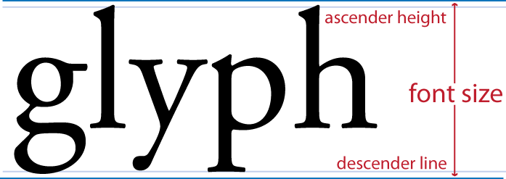
The size of a font (type) is measured in a unit called?
07 Typography

Slide 6

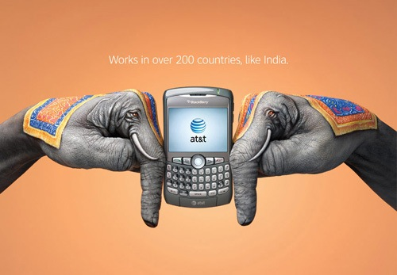
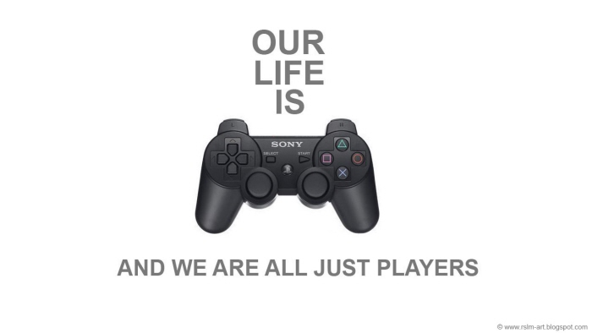
This is a form of visual communication and a process by which visual information is given form and structure, so as to communicate a message.
06 Graphic Design

Slide 7
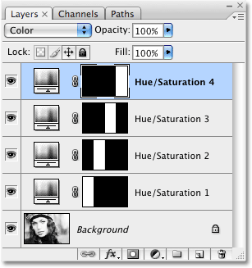
What is the correct format extension to save as when you are still working with an image that has layers in Photoshop?
05 Image File Formats

Slide 8
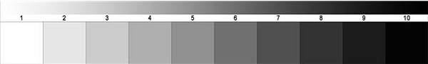
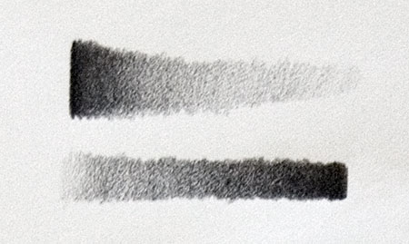
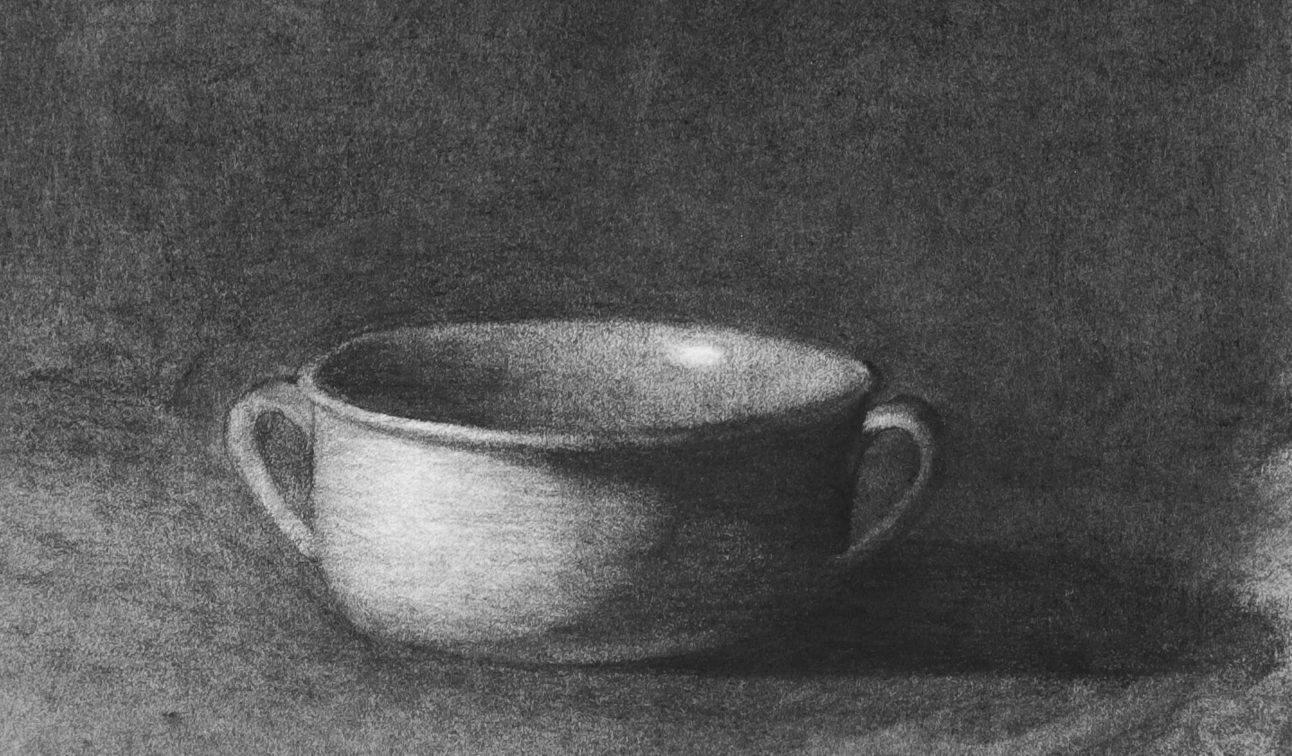
This is considered to be the lightness or darkness of a color or of a neutral gray. It can imply a three-dimensional definition that indicates both the outline and mass.
02 Design Theory

Slide 9
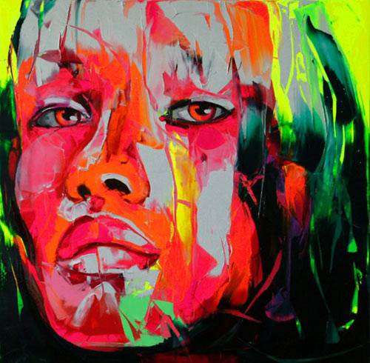
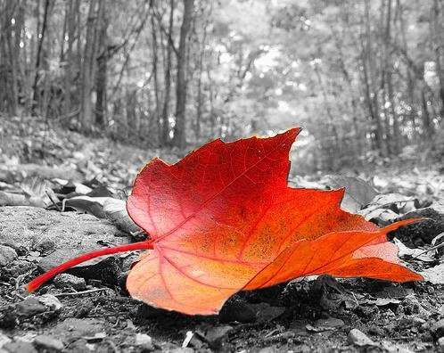
What art principle focuses on differences and contrasts in a work of art?
02 Design Theory

Slide 10
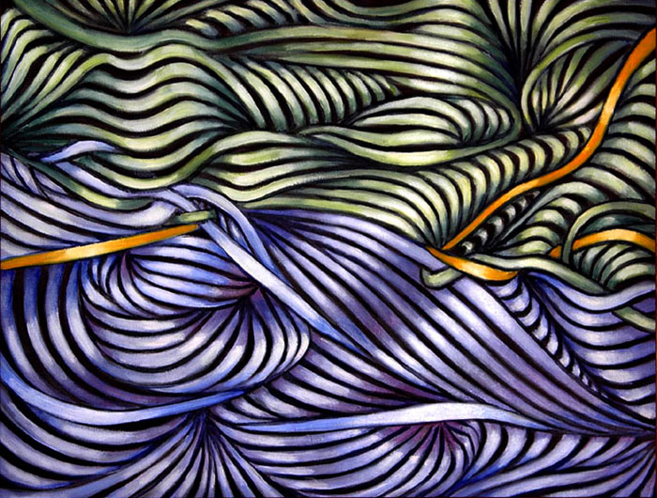
This principle of art is created by repeated positive shapes separated by negative spaces.
02 Design Theory

Slide 11
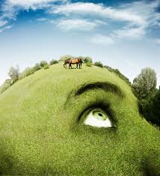
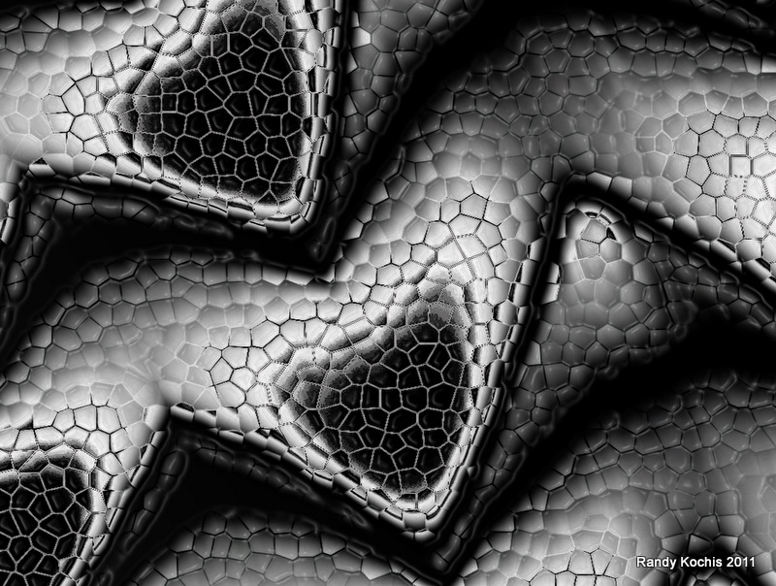
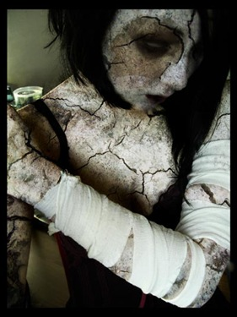
What element of art is the nature of a material's surface that is noticed by our sense of touch or sight.
02 Design Theory

Slide 12
Altering images with a computer, digital camera or scanner, and printer is called?
04 Digital Imaging

Slide 13
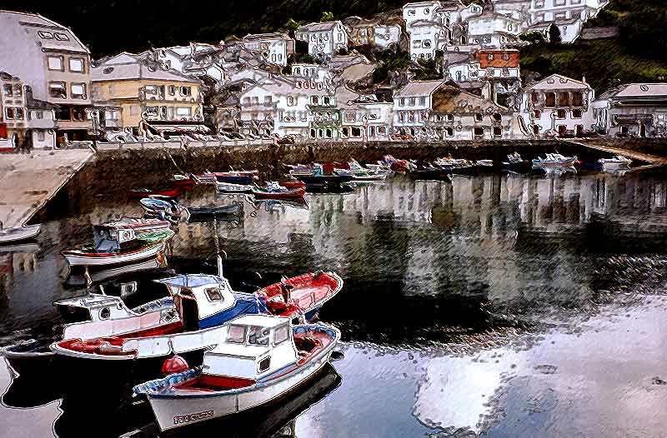
Photoshop lets you apply effects (visual changes) to images to alter their appearance called?
04 Digital Imaging

Slide 14
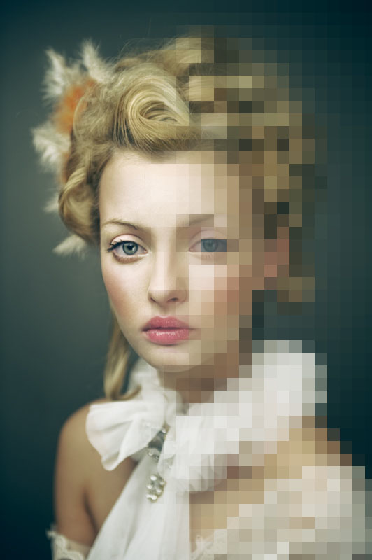
The word pixel comes from these two words and means?
04 Digital Imaging

Slide 15
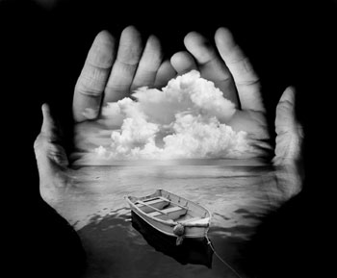
This film photographer is best known for his surrealistic film photographs within two or more separate images are combined, in a darkroom using several enlargers.
04 Digital Imaging

Slide 16
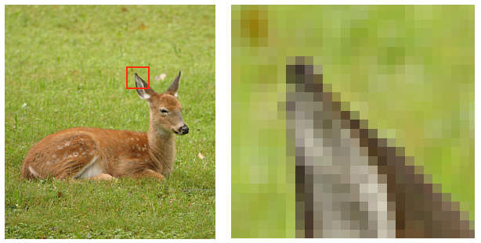
Digital images are measured by there resolution called?
04 Digital Imaging

Slide 17
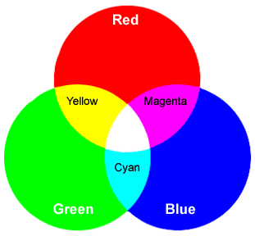
The three additive color primaries are?
08 Computer Color

Slide 18
Decreasing the intensity of a color by making it lighter is done by adding what color?
03 Color Theory

Slide 19
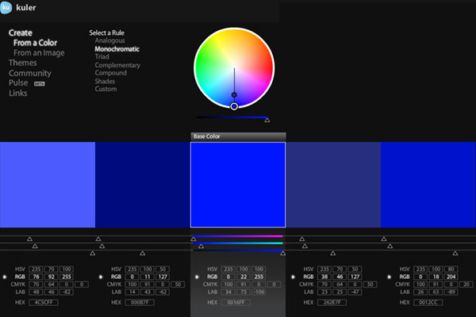
Relying on only one color, with variations in intensity and value is what type of color scheme.
03 Color Theory

Slide 20
This is a process by which visual information is given form and structure, so as to communicate a message.
06 Graphic Design

Slide 21
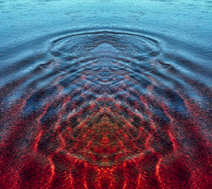
This image uses what type of balance?
02 Design Theory

Slide 22
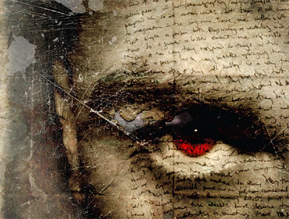
Special stress given to an element (line, color, shape, etc.) to make it stand out is what principle?
02 Design Theory

Slide 23
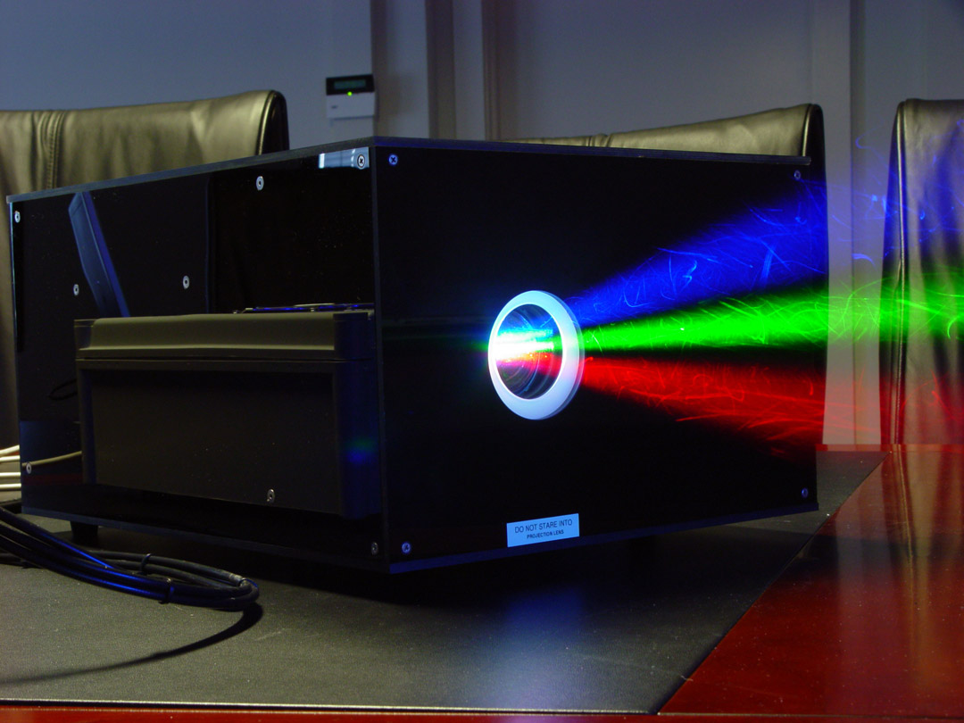
This is the color model of light (conventional or digital) and is used for all monitors & projection systems.
08 Computer Color

Slide 24
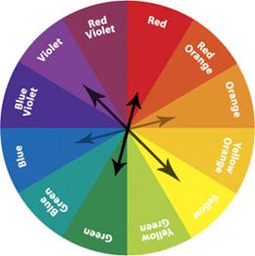
Colors found opposite each other on the color wheel, providing high color contrast are called?
03 Color Theory

Slide 25
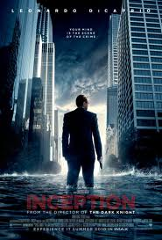
In Photoshop, images like this are put together from several images and created with what feature in Photoshop?
04 Digital Imaging

Slide 26
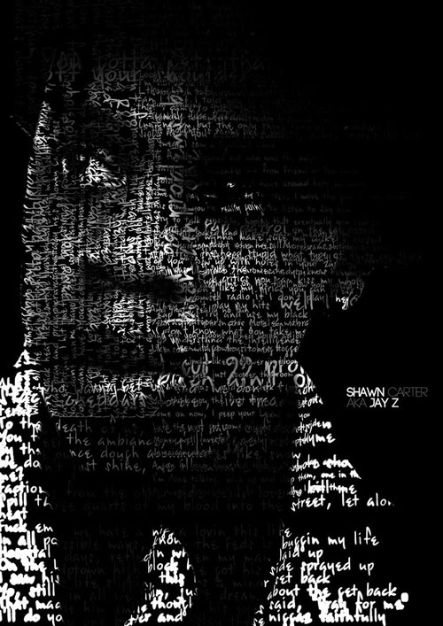
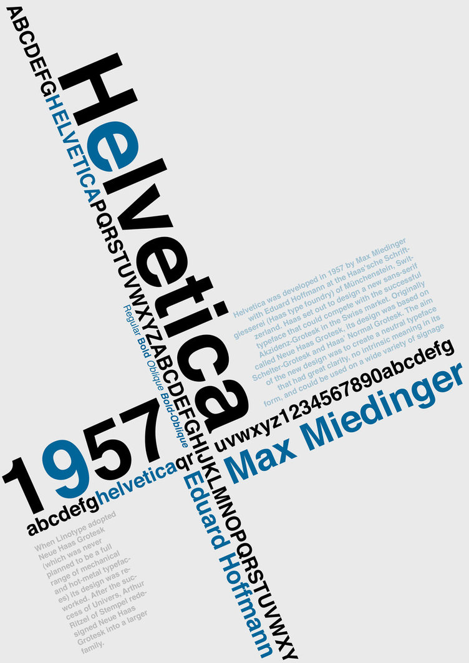
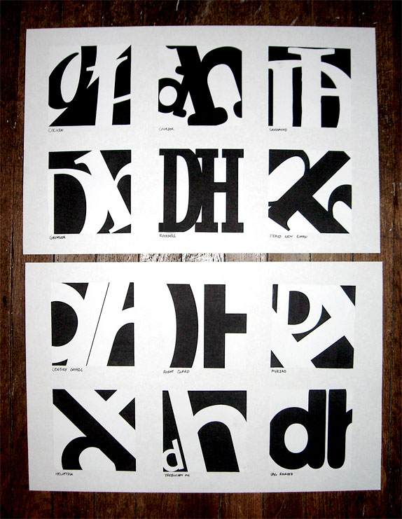
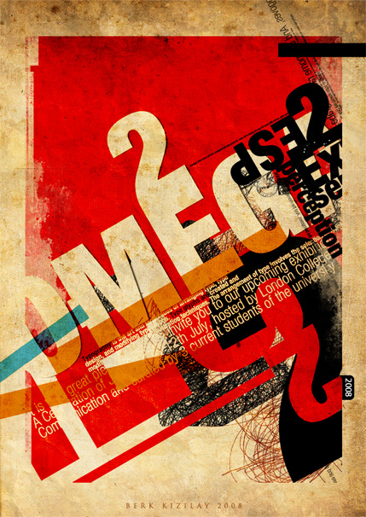
What is the design of letterforms and the arrangement of them on a page or screen called?
07 Typography

Slide 27
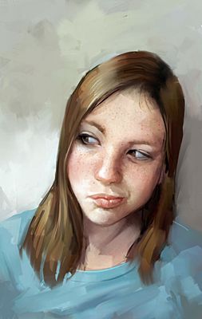
This is Corel Painter’s native file format?
05 Image File Formats

Slide 28
Which one of the following describes the artwork?
Keep only one of the following statements to answer the question above.
The photograph is successful showing a Surrealistic fantasy like image.
The photograph has symmetrical balance with great contrast and value changes
The photograph contains images of clouds, hands, and a barred window.
The photograph seems to be communicating ideas of human choice of being either confined or free.
09 Art Criticism

Slide 29
Which one of the following analyzes the artwork?
Keep only one of the following statements to answer the question above.
The photograph is successful showing a Surrealistic fantasy like image.
The photograph has symmetrical balance with great contrast and value changes
The photograph contains images of clouds, hands, and a barred window.
The photograph seems to be communicating ideas of human choice of being either confined or free.
09 Art Criticism

Slide 30
Which one of the following interprets the artwork?
Keep only one of the following statements to answer the question above.
The photograph is successful showing a Surrealistic fantasy like image.
The photograph has symmetrical balance with great contrast and value changes
The photograph contains images of clouds, hands, and a barred window.
The photograph seems to be communicating ideas of human choice of being either confined or free.
09 Art Criticism

Slide 31
Which one of the following evaluates (successful or unsuccessful) the artwork?
Keep only one of the following statements.
The photograph is successful showing a Surrealistic fantasy like image.
The photograph has symmetrical balance with great contrast and value changes
The photograph contains images of clouds, hands, and a barred window.
The photograph seems to be communicating ideas of human choice of being either confined or free.
09 Art Criticism

Slide 32
Save this to your Google drive and go over it to study for the exam

