Slide 1
The Elements & Principles of Art
Brian Cavanaugh
Computer Art Period 4
Mr. Brady

Slide 2
The Elements
Line
Shape
Form
Space
Color
Value
Texture

Slide 3
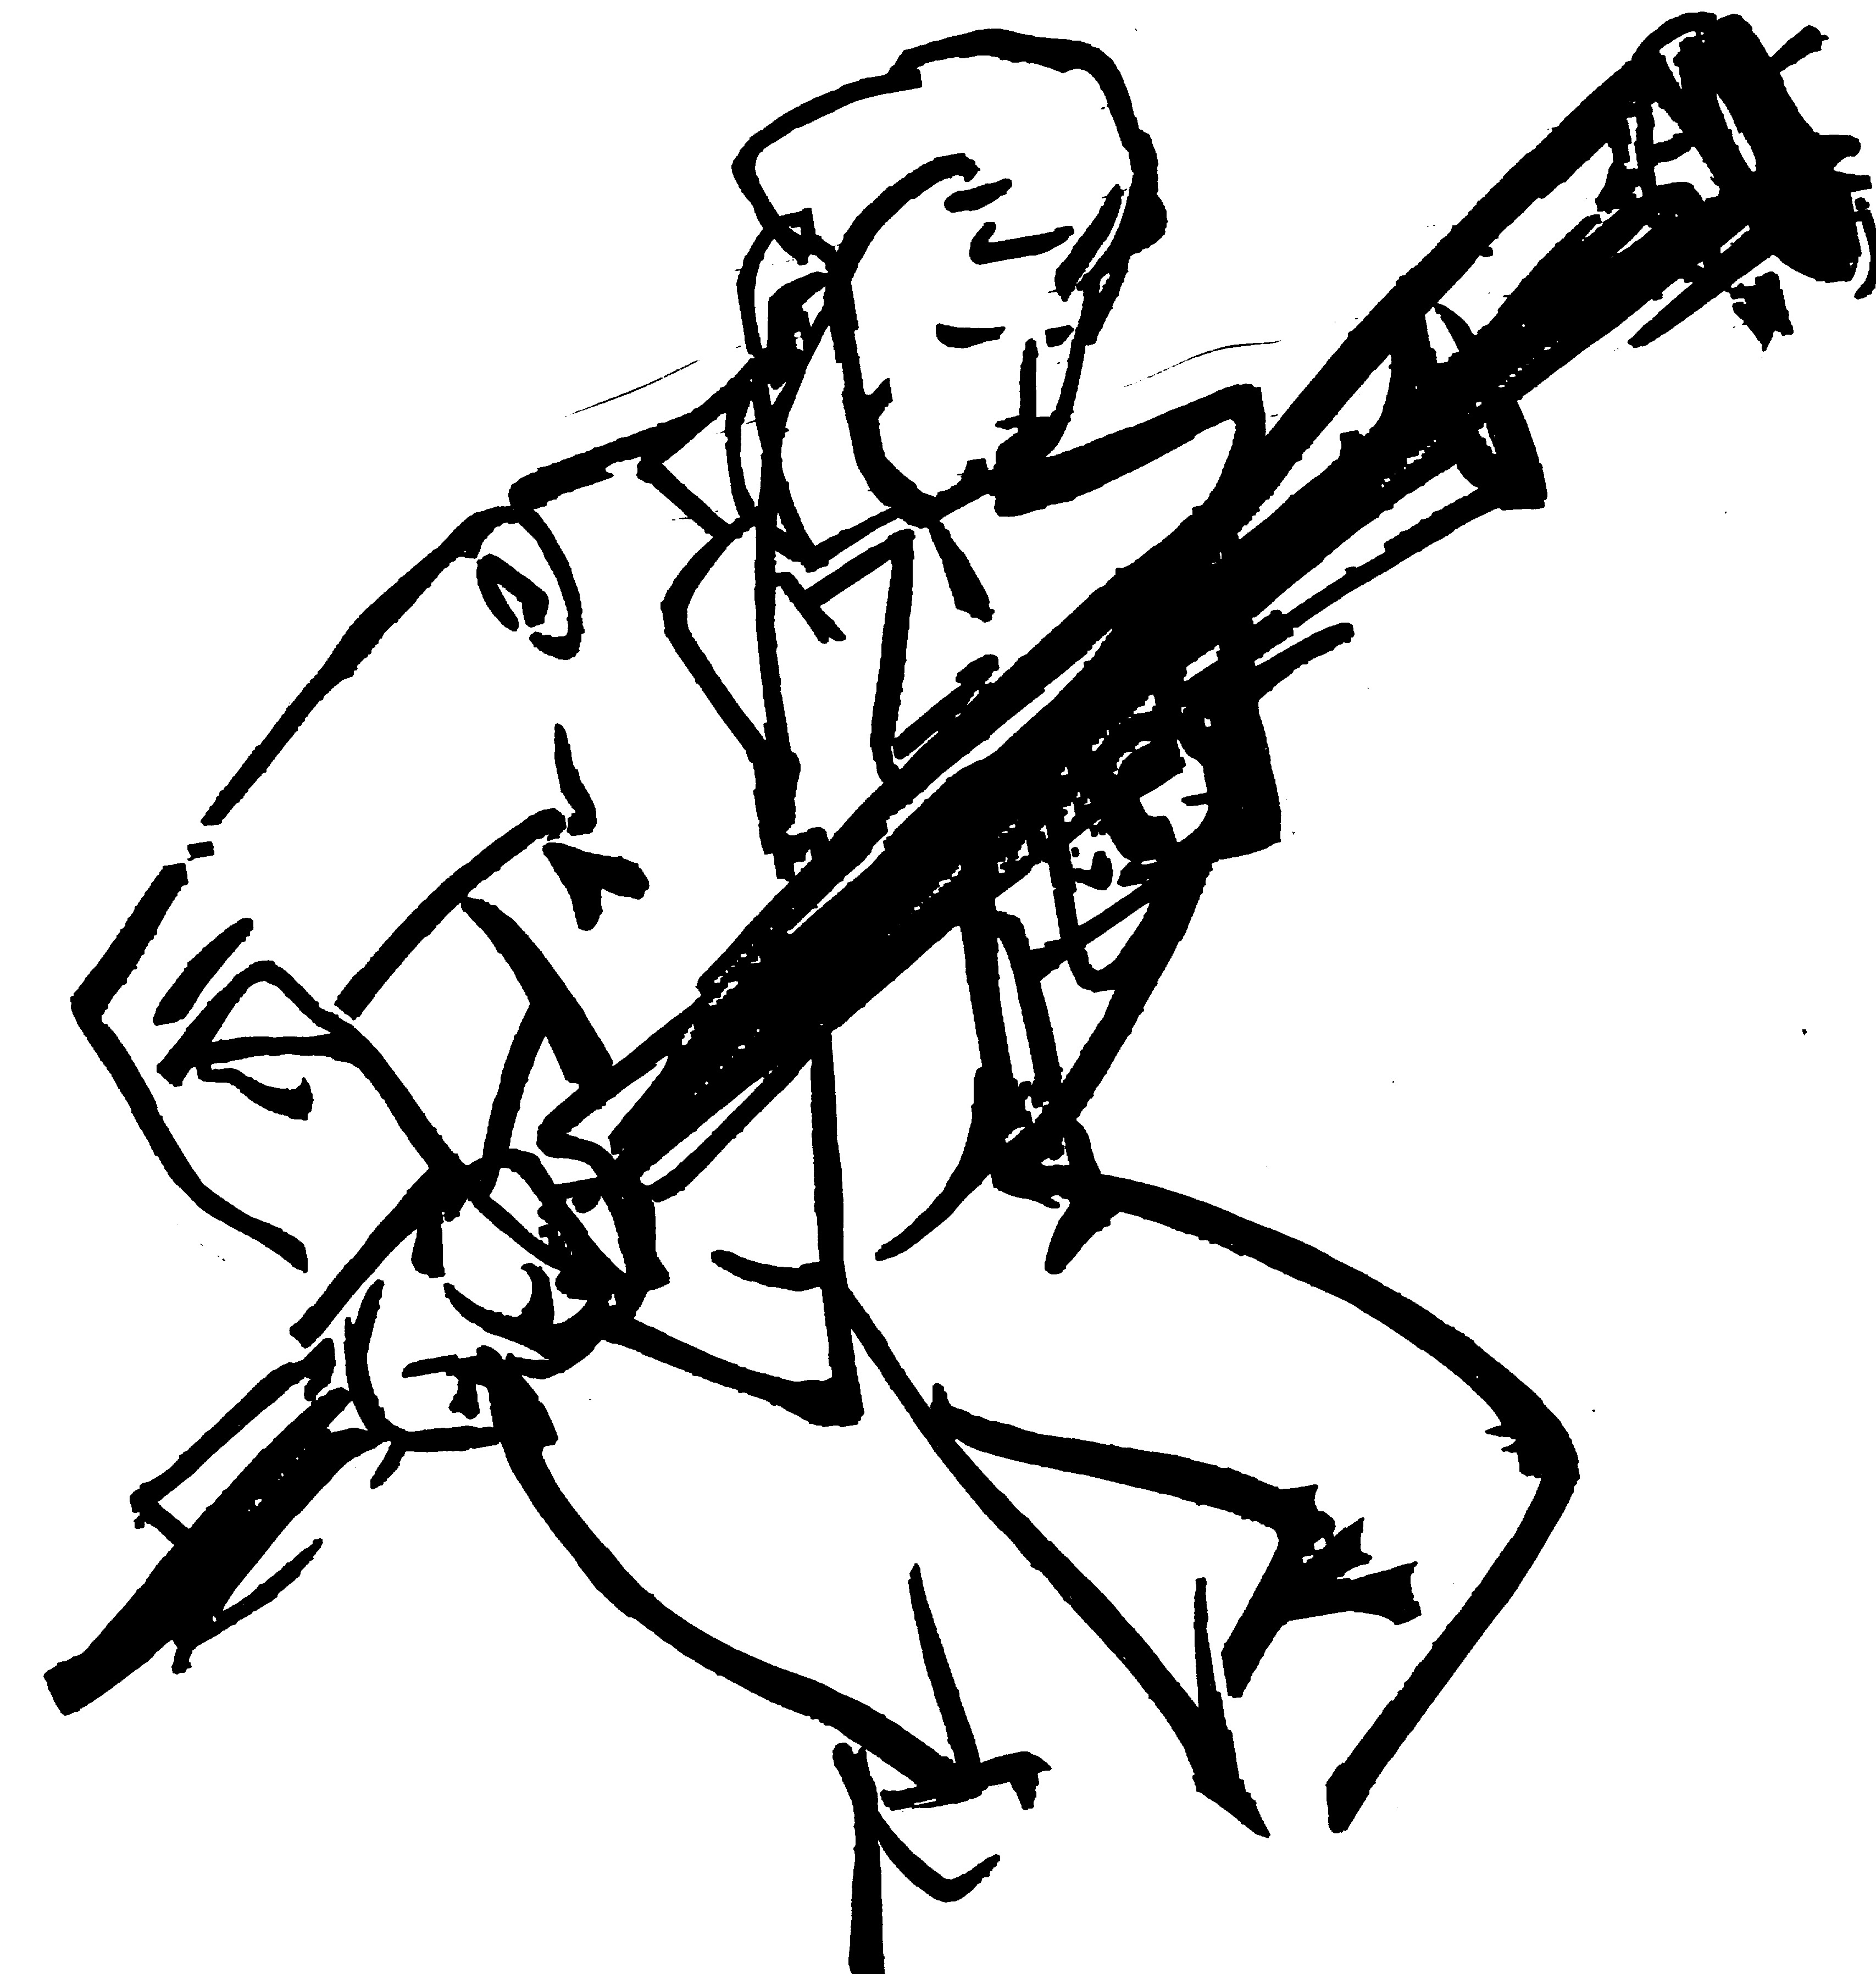
Line
Lines are the marks left by the painting tools which define the edges of objects in artwork. Their shape and thickness may express movement or tone
.A point pulled through space
.Values meeting can create lines
.Can empathizes movement
Here the lines are all the same width and opacity. The lines give the feeling of the movement of the musician.

Slide 4
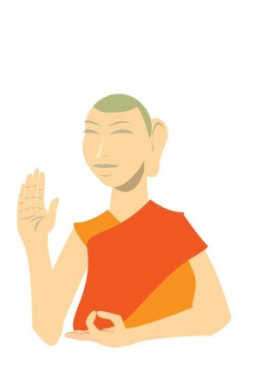
Shape
Shapes are formed from the meeting of lines and the enclosing (or perceived enclosing) of areas in two-dimensional space
This image of a monk is very simple in color and shape. The shapes of his garb are flat and geometric, and his body is flat and organic

Slide 5
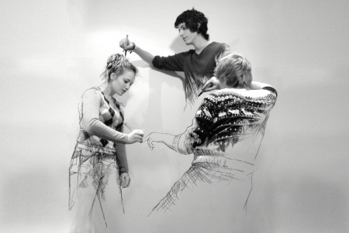
Form
Form is the three-dimensional counterpart to shape
Here you can see the distinction between the flat shapes and the 3 dimensional transition in each person

Slide 6
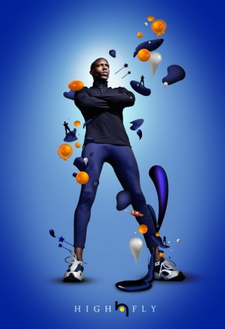
Space
Space is an empty place or surface in or around a work of art. Space can be two-dimensional, three-dimensional, negative and/or positive.
There is a distinct edge between the positive and negative space in this picture. The man is the positive space and the gradient blue background is the empty negative space.

Slide 7
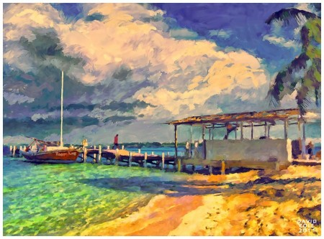
Color
Color refers to the hue (ex. red vs. orange) and intensity or brightness (ex. neon green vs. yellow-green) of the colors used. It may also refer to the value, or the darkness, or the color.
The artist went through the entire color spectrum here. Also the intensity of the color from the sunlight really catches your attention

Slide 8
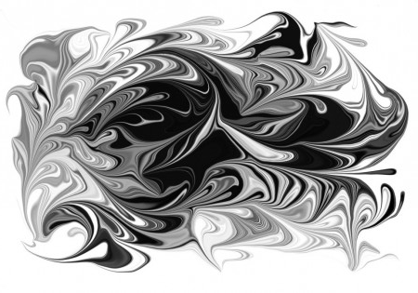
Value
Sometimes combined with color, value describes the lightness or darkness of a color
The swirls of value entertain the eye. There is no color in the piece, only varying degrees of value

Slide 9
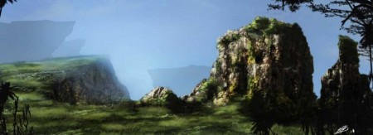
Texture
Texture is the way something feels when you touch it. Artists also create the illusion of texture in artworks such as paintings, drawings and prints.
Here you can see two types of texture the rough rocky texture and the soft grass in the same image.

Slide 10
The Principles
Rhythm
Movement
Pattern
Balance
Proportion
Variety
Emphasis
Harmony
Unity

Slide 11
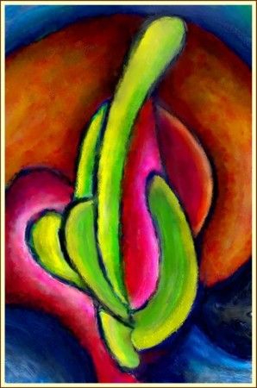
Rhythm
Visual rhythm makes you think of the rhythms you hear in music or dance. Artists create visual rhythm by repeating art elements and creating patterns.
While this may not be a realistic work of a cactus, the artist uses rhythm to give the cactus a new flowing shape. Its creates the mood with his alteration

Slide 12
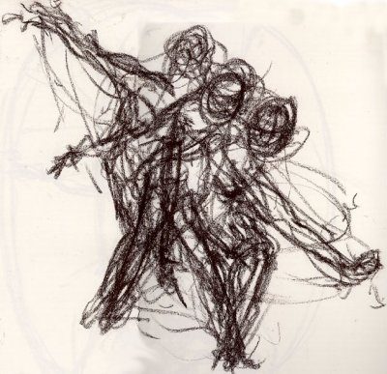
Movement
Movement is the visual flow through the composition. It can be the suggestion of motion in a design as you move from object to object by way of placement and position.
The artist used quick stokes of his charcoal to create a moving figure. The artist also drew the figure where it will be in the future to show its path of movement.

Slide 13
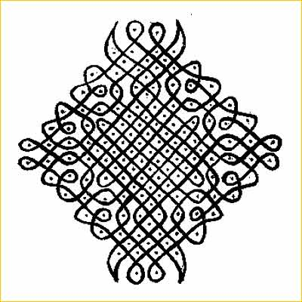
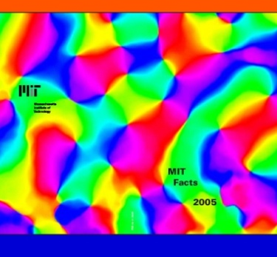
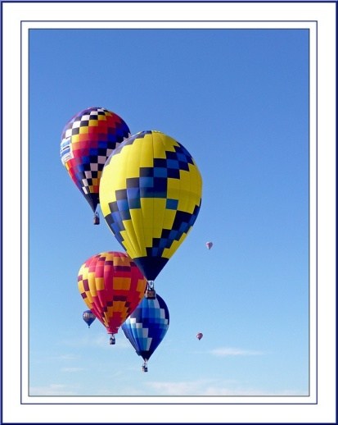
Pattern
Pattern is one of the principles of art. Artists create pattern by repeating a line, shape or color over and over again.

Slide 14
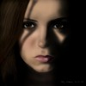
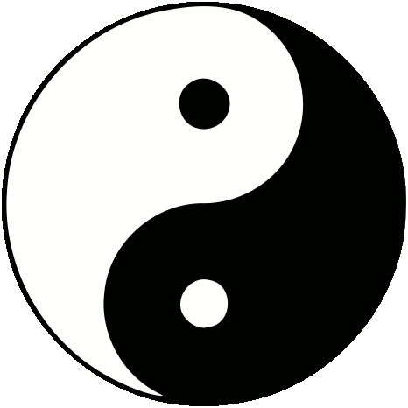
Balance
Balance is one of the principles of art which describes how artists to create visual weight
Both of these images are balanced

Slide 15
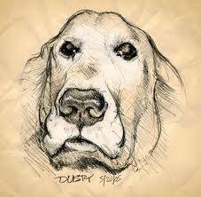
Proportion
Proportion is one of the principles of art which describes the size, location or amount of one thing compared to another.
The proportions of this man is very accurate and realistic
Here is an example of foreshorting. The dogs nose isn't really that big, but due to our perspective , it looks that way

Slide 16
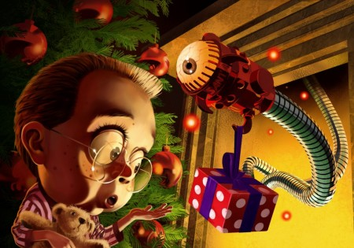
Variety
Variety occurs when an artist creates something that looks different from the rest of the artwork. An artist may use variety to make you look at a certain part or make the artwork more interesting

Slide 17
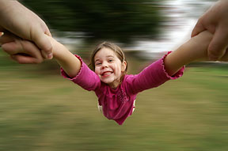
Emphasis
Artists use emphasis to make certain parts of their artwork stand out and grab your attention. The center of interest or focal point is the place the artist draws your eye to first.
The crisp girl over the blurred background emphasizes movement and the focal point.

Slide 18
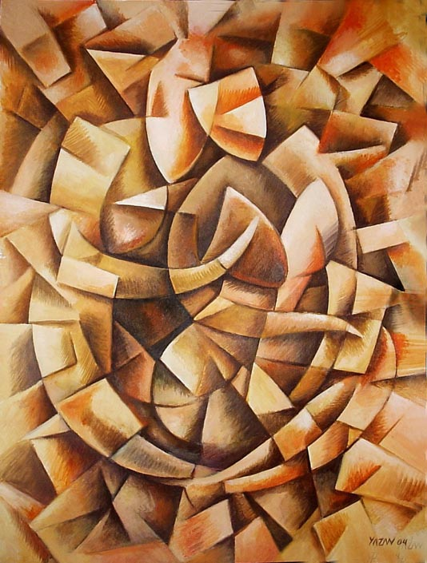
Harmony
Harmony brings together a composition with similar units. If your composition was using wavy lines and organic shapes you would stay with those types of lines and not put in just one geometric shape
The entire picture is random and changing, but the techniques are in sync with each other. Also the colors are harmonious

Slide 19
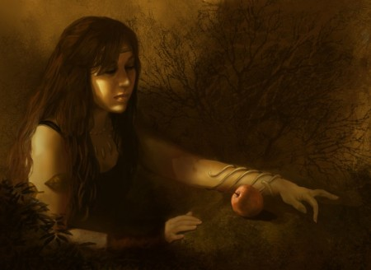
Unity
Unity is the feeling that everything in the work of art works together and looks like it fits
The mood, the colors and the form of the picture all work together for a overall sense of unity.

